Slide 1
Preliminary Design Review
February 18th, 2020

Slide 2
Agenda
Project Overview
Assembly
Components & Prototypes
Object-Grabbing Mechanism
Mission Navigation Strategy
Timeline
Questions (for Nick and Caleb)

Slide 3
Project Overview
What have we accomplished so far?
Finalized chassis design
Finalized most components on chassis (except for Grabbing Mechanism)
Assembled & wired full rover (except for Grabbing Mechanism)
Began autonomous navigation code
Running initial robot movement tests (forward, backward, turnX, stop)
Running initial ultrasonic reading tests (getXDistance, etc.)

Slide 4
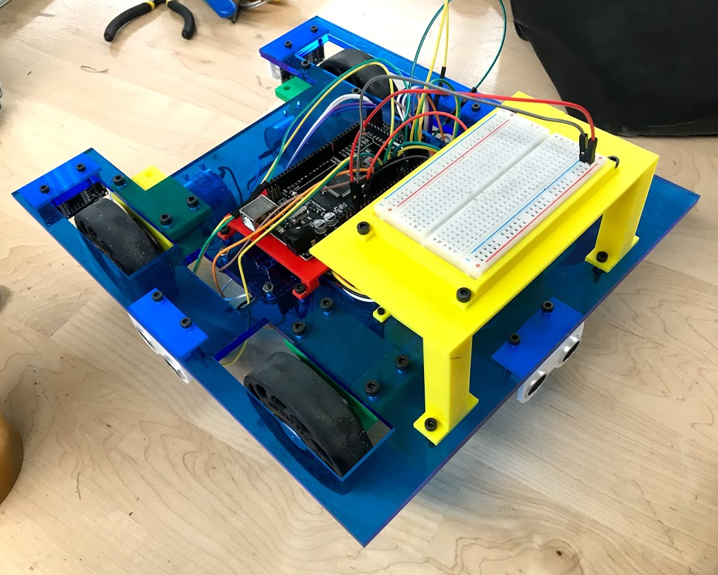
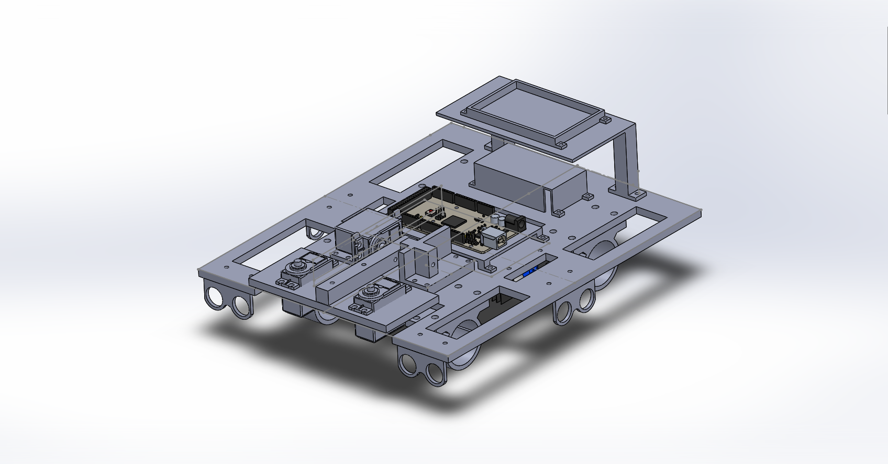
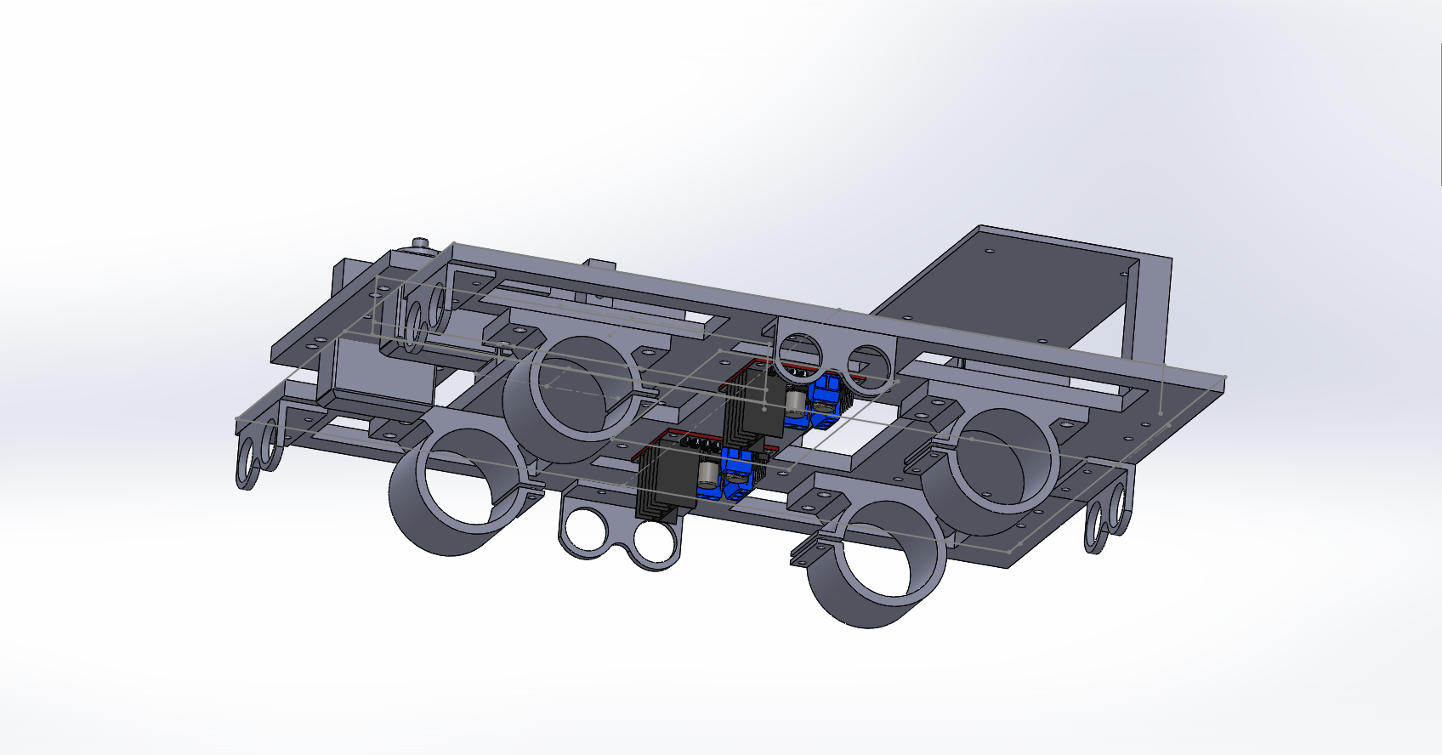
Assembly

Slide 5
Raised Platform
Battery Holder
Main Servo with Bracket
Motor
Mounts
Main Servo Arm
Arduino Mega Holder
Main Servo
Arm Support

Slide 6
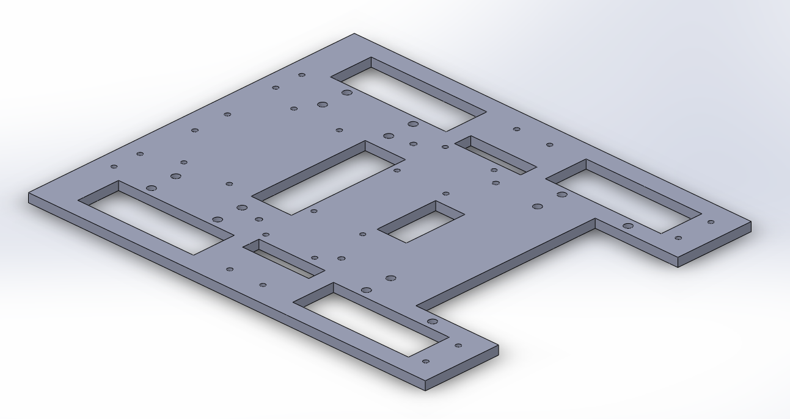
Components & Prototypes
Notes:
Chassis
-laser cut out of wood/acrylic (prefer acrylic, doubled up to 0.25” for extra strength)
-cut-out holes for wires (4 holes) towards middle of board
-originally designed chassis to have wheels not “enclosed” by chassis, but wanted to in the end, as this allows:
-ultrasonic sensors to be mounted at the same level as wheels
-good rover design, as provides protection of wheels from objects (if there were any on this board) that could cause unintentional movements/veering

Slide 7
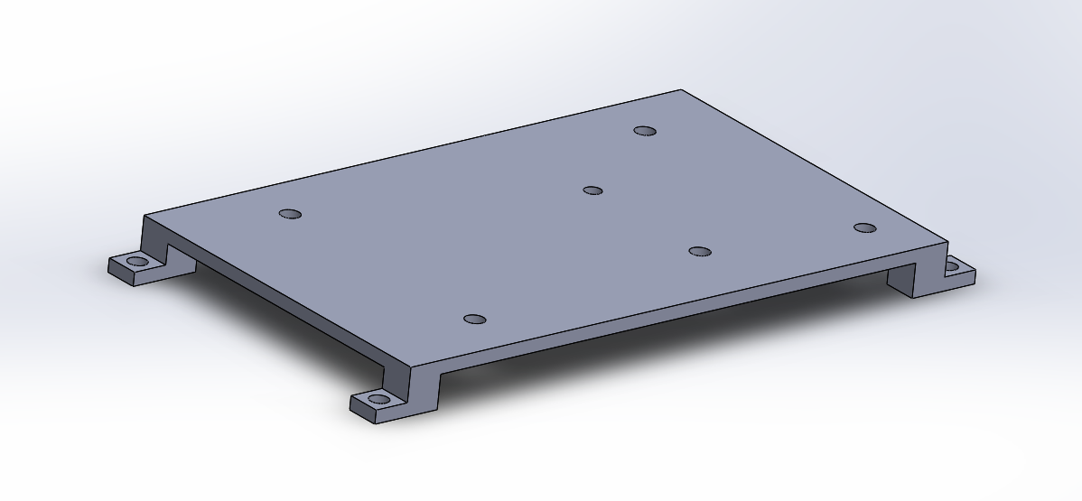
Components & Prototypes
Notes:
Arduino Mega Holder:
-to allow for ease of pressure on solder heads on bottom of board
-allows for wiring through holes cut into chassis that are right next to the sides of the holder

Slide 8
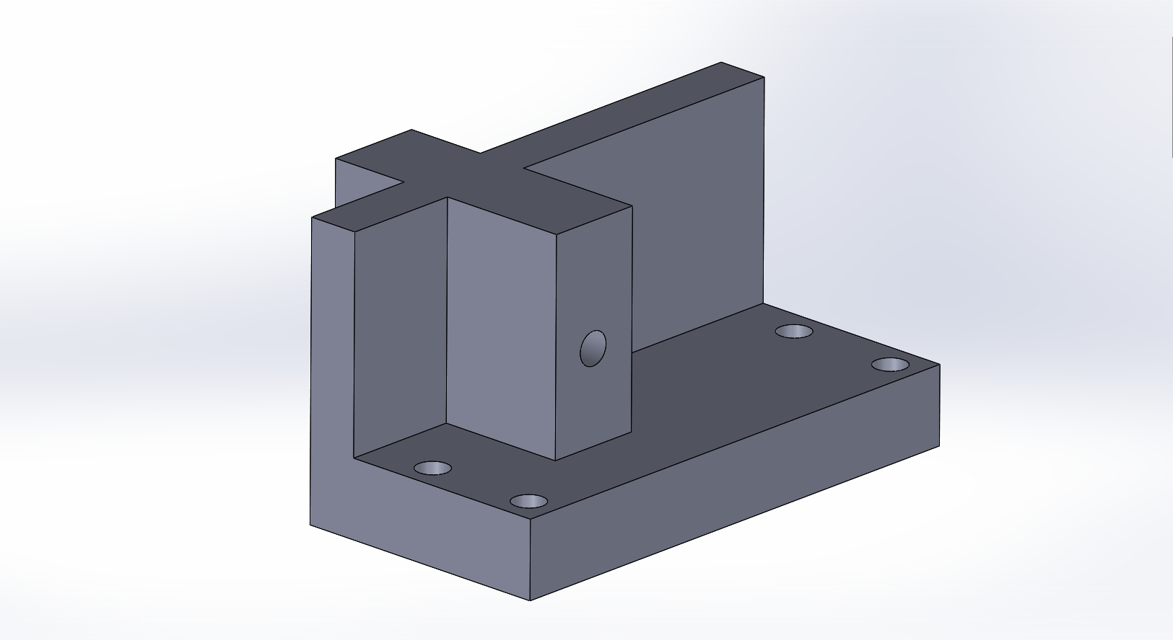
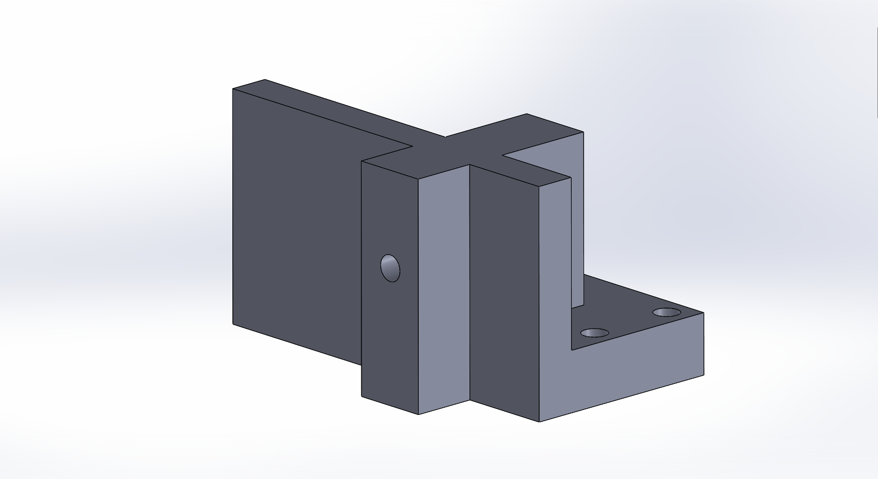
Components & Prototypes
Notes:
Servo Arm Support
-for support on other attend of servo arm; helps protect main arm servo from strain
-based on design of regular servo mount, which allows us to look into 2 servos, connected to the main arm in case of weight being too heavy

Slide 9
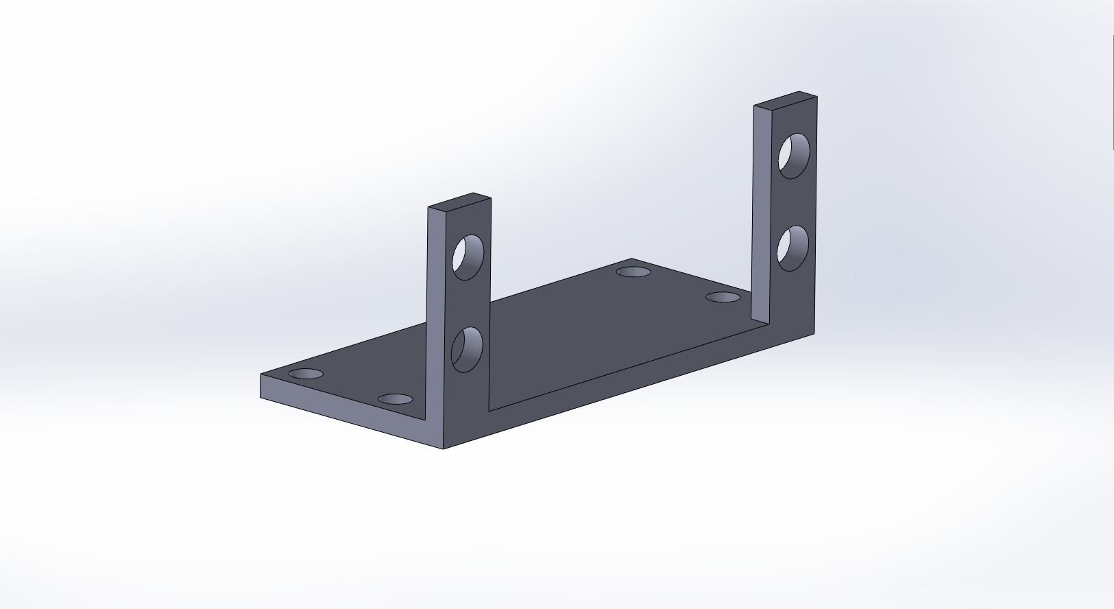
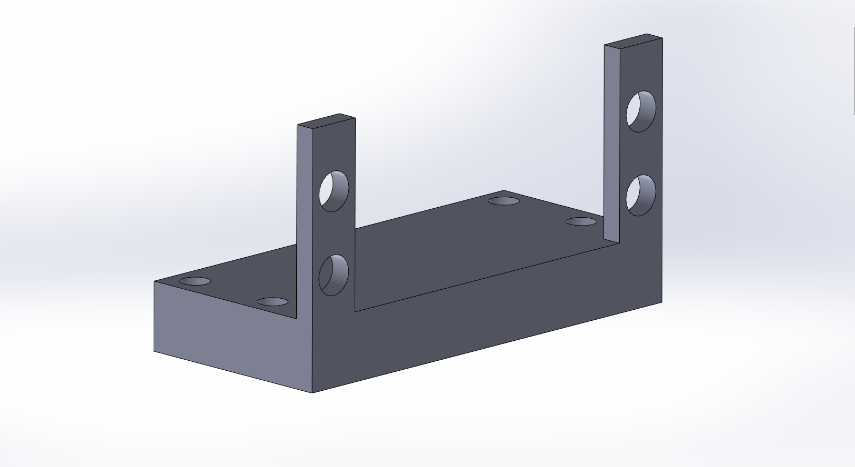
Components & Prototypes
Notes:
Servo Mounts:
-original perfectly fine for mounting servo with ease and sturdiness
Raised Servo mount because:
-need for a bit more clearance with arm’s mount on servo and the chassis (show with physical rover)
-something we didn’t keep in mind when designing the chassis/servo mounts in the first place. Lesson learned: consider physical ability limits of moving components (i.e. clearance, full range of motion, ability to actually build/produce, etc.)

Slide 10
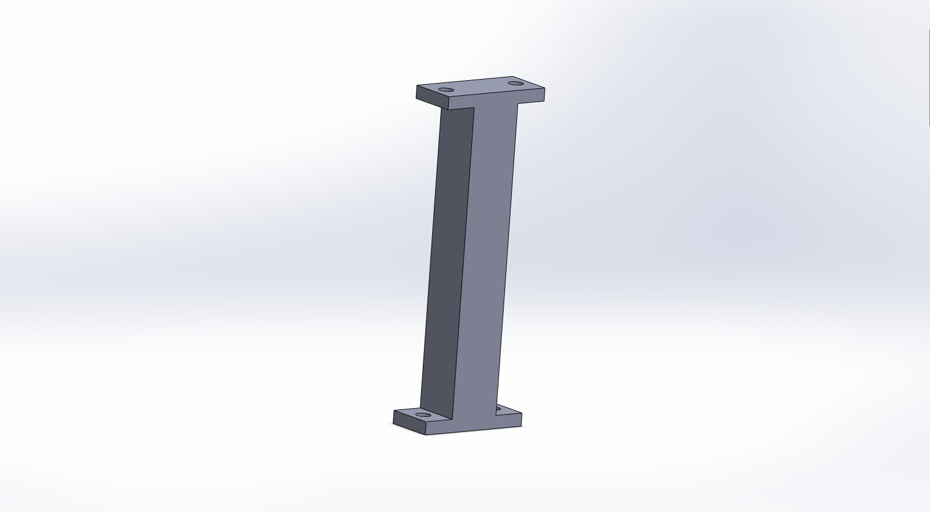
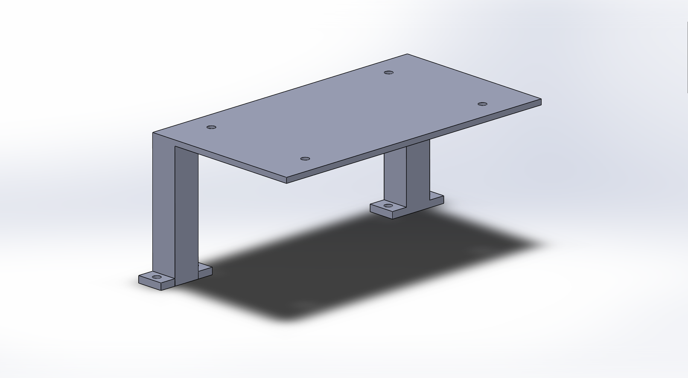
Components & Prototypes
Notes:
Originally raised second platform (second chassis) for saving of physical space on chassis
-modified size of second platform, and now into one piece to ease the construction process.
Issues:
-Pillars too tall, issue with potentially having to prototype/change wiring once we screw in the second level
-Size of second platform unneeded; platform that is only the size of the breadboard is needed. Originally thought to potentially have something more on the platform, but decided against it.

Slide 11
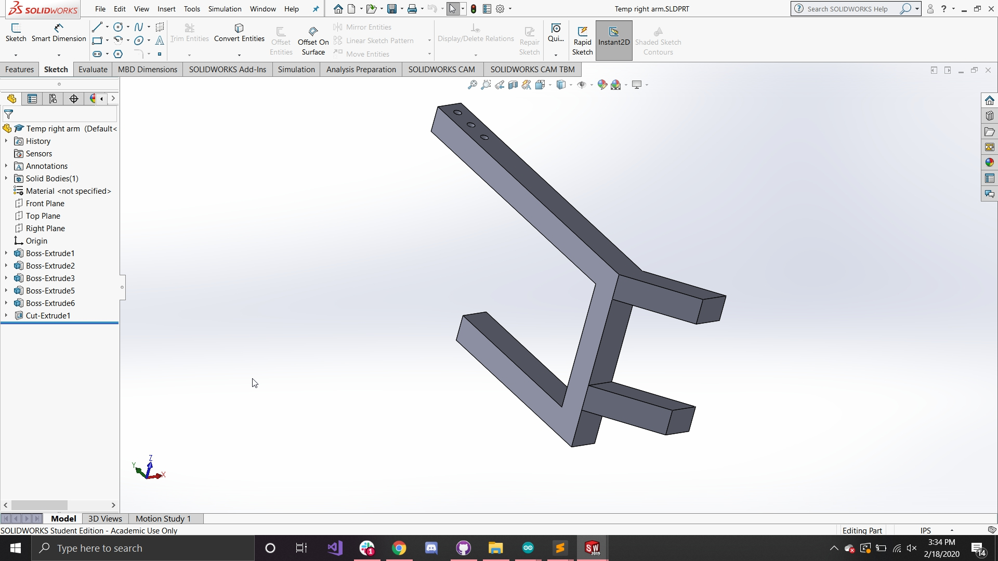
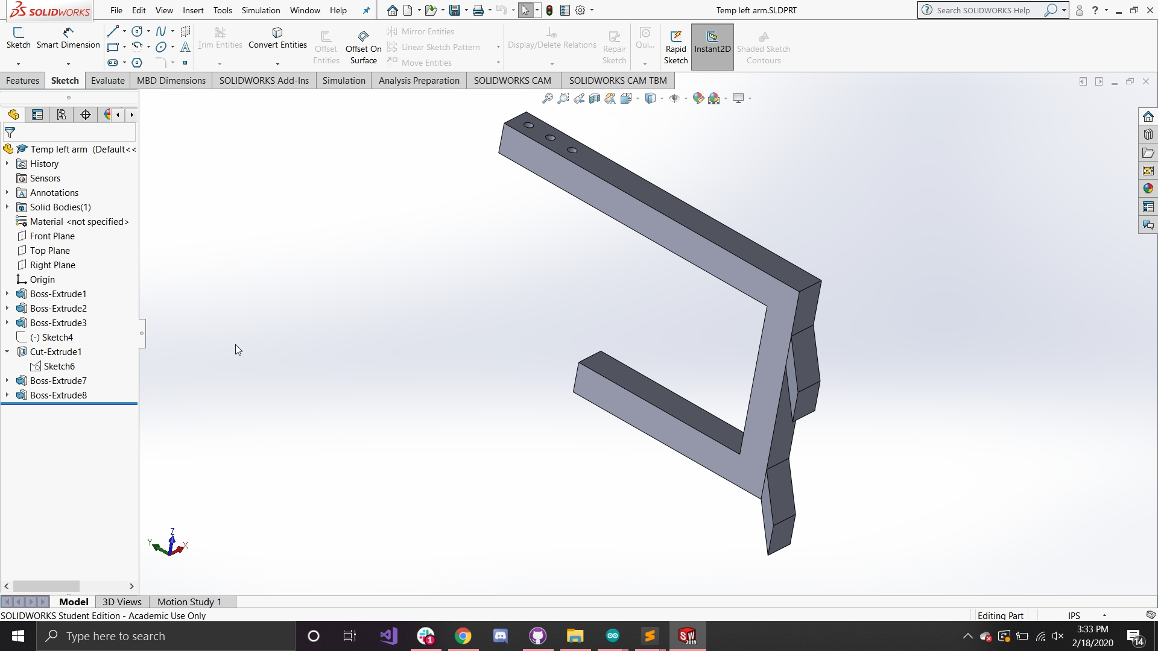
Object-Grabbing Mechanism
Will pick object off floor
Rubber lining the “claw” arms to increase grip strength
Still prototyping mechanism to maximize grip strength
Notes:
Some ideas for maximizing: -modifying the angle
-modifying the length out from the rover
-modifying where the servos are mounted on the front platform
-adding rubberband-give flexible “give” mechanism, which will have the rubber bands be attached to it
-reason why we don’t have this yet is because we wanted to start simple and then work from there, as we were noticing that we weren’t making any progress towards actual physical prototypes (designing and 3D-printing)

Slide 12
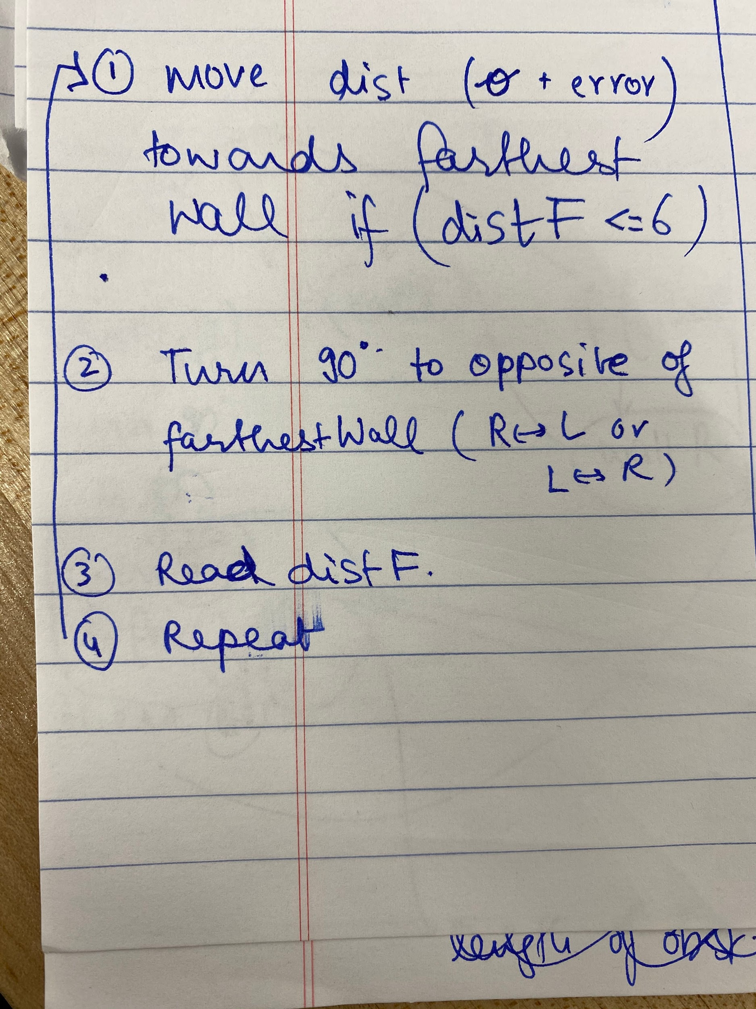
Navigating the Maze
Problems we have tackled:
Determining the forward distance that we want to consider in every case
Determining how to avoid an obstacle in each case (centred obstacle vs 2 obstacles)
Areas to tackle:
How to stop turning at 90 degrees (other than just dead-reckoning)
Ensuring veer does not alter our orientation

Slide 13
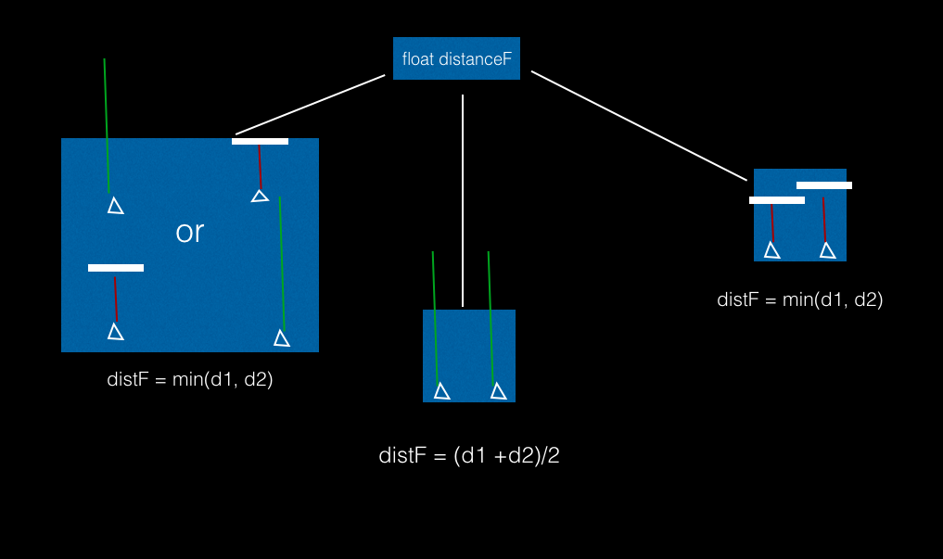
Determining the distance to use as the forward distance

Slide 14
Navigating the Search Area
Aspects to Take Care Of:
Locate ourselves in the search area
Move forward out of Maze, read distance to S wall using F ultrasonic (align vertically)
Read distance to E/W wall using L/R ultrasonic (align horizontally)
Move to object (based on given set of coordinates) for vertical/horizontal displacement (dead-reckoning/“hard-coded” in)
Grab object and lift off ground
Locate ourselves in the search area
Turn towards South Wall, and repeat previous “Locate”
Move to drop-off zone (based on given set of coordinates) for vertical/horizontal displacement

Slide 15
Timeline
Week 9:
-Finalize rover (grabbing mechanism included) with mechanism-specific testing on extra rover
-Debug rover operation code on full course
Week 7:
-Present PDR
-Finalize Chassis Design/Assembly
-Prototype Grabbing Mechanism
Week 6:
-CAD Chassis
-CAD Assembly
-Perform initial prints and cuts of chassis and parts (excluding grabber)
-Develop rover operation strategy and pseudocode
Week 8:
-Finalize grabbing mechanism
-Begin operation testing -Finish MatLAB mapping code (verify with actual rover test data)
Week 10:
-Turn in report
-Run rover!

Slide 16
Questions
Incorporating “give” into the grabber mechanism
How exactly? Rubber attached to rubber band mounted at claw ends?
Fixing apparent veer of rover’s motors
Differentiation between object and wall

